Slide 1
AI-Powered Semantic Matching System for Candidate-Job Ranking

Slide 2
Project Overview
Goal & Problem Statement
Data Collection, Preparation & Feature Engineering
Semantic Scoring and Overall Score Calculation
Test Dataset Generation and Model Training
Model Evaluation & Performance Predictions
Key Takeaways
Future Enhancements

Slide 3

Goal
Automate and enhance candidate shortlisting by calculating the semantic relevance of candidates to job roles.

Slide 4
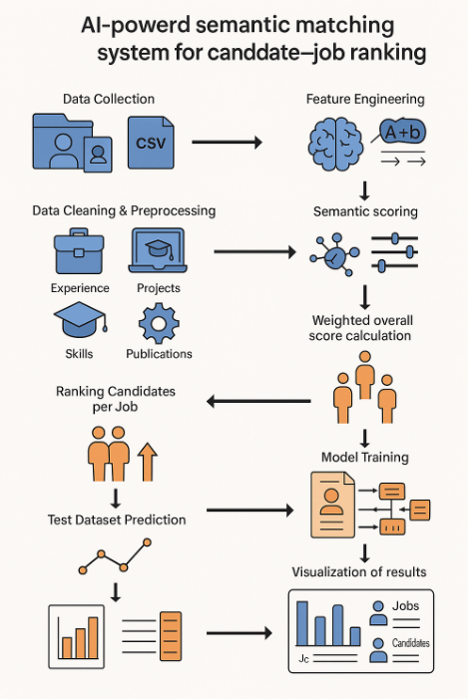
Flow

Slide 5

Problem Statement
Manual resume screening is inefficient and often biased.
Traditional keyword-based systems lack context and semantic understanding.
A semantic model is needed to assess candidate-job compatibility more intelligently.

Slide 6
Data Collection & Preparation
Sources: Candidate profiles and job descriptions stored in structured CSV format.
Candidate Fields: Experience, Projects, Education, Skills, Publications.
Job Fields: Responsibilities, Qualifications, Skills.
Data Cleaning: Addressed encoding issues, filled missing values, normalized and preprocessed text fields.

Slide 7
Feature Engineering
Parsed and cleaned relevant sections from text fields using regex.
Extracted standardized components from nested entries (e.g., experience, skills).
Prepared domain-specific semantic comparison inputs.

Slide 8
Effective delivery techniques
Semantic Scoring Using Sentence-BERT Ensemble.
Models Used
all-mpnet-base-v2
intfloat/e5-base
BAAI/bge-base-en-v1.5
Domains Evaluated: Experience, Projects, Education, Publications, Skills.
Methodology:
Text embeddings created using each model.
Ensemble Cosine similarity calculated between candidate and job embeddings.
Top 3 similarities selected and averaged per domain

Slide 9

Overall Score Calculation
Weight Distribution:
40% Experience
40% Projects
6.67% Education
6.67% Skills
6.67% Publications
Output Feature: overall_semantic_match_score
Candidates were ranked per job using this final score
column: Label (Ranking).

Slide 10
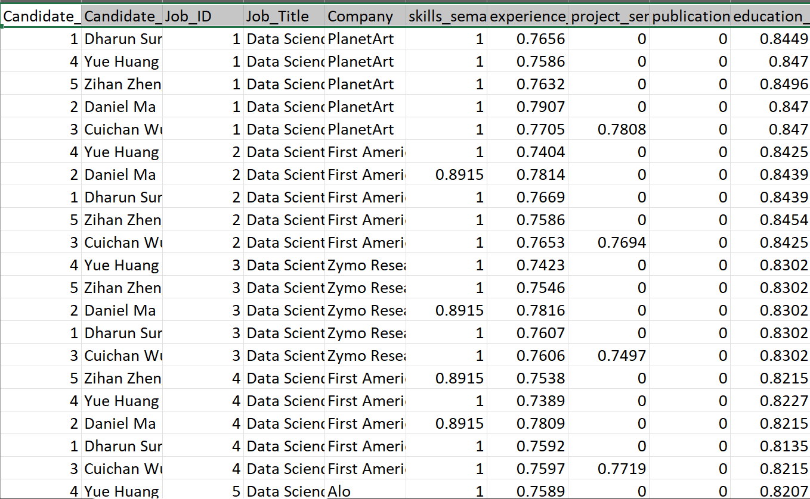
Test Dataset Generation
Created test data with 5 jobs and 5 new candidates.
Applied identical preprocessing
and scoring pipeline.
Left out final rank and overall score
to test model predictions.

Slide 11
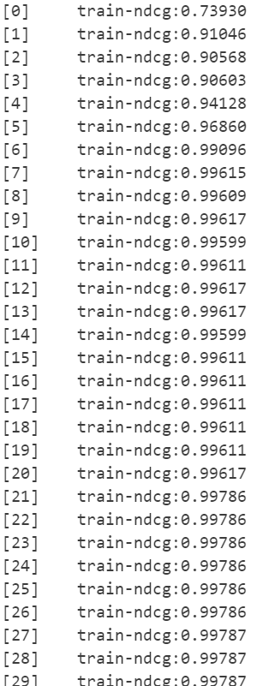
Model Training with XGBoost Ranking
Model Type: XGBoost Gradient Boosted Trees
Objective: rank: pairwise for learning to rank
Evaluation Metric: NDCG (Normalized Discounted Cumulative Gain)
Input Features: Five domain-specific semantic scores
Target Label: Label (Ranking)
Grouping: By Job_ID
Training: 1000 boosting rounds with early stopping
Model Saved As: xgb_ranking_model.ubj

Slide 12
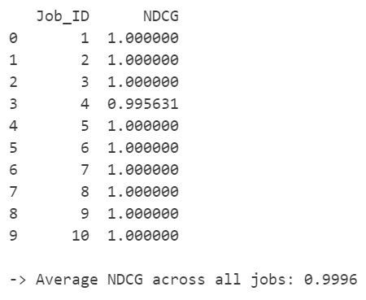
Model Evaluation & Performance
Evaluated using built-in NDCG metric during training.
Observed strong ranking correlation between true and predicted scores.
High interpretability using feature-wise semantic contributions.

Slide 13
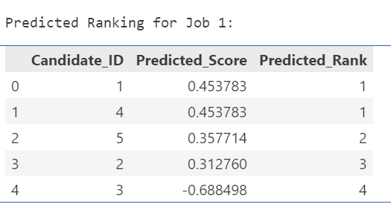
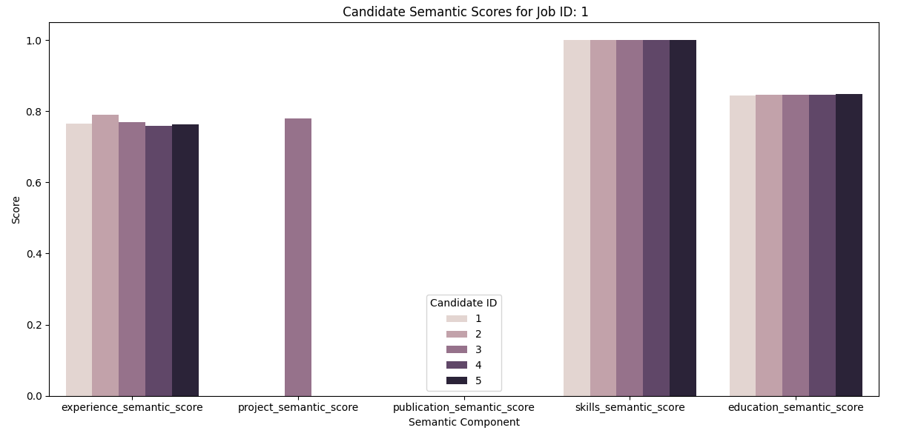
Test Predictions & Visualization
Predictions:
Computed scores and rankings for unseen test candidates.
Visualization:
Candidate vs. Job semantic bar charts (per domain)
Predicted ranks table for each job
Insight: Clear alignment between semantic match and rank predictions

Slide 14
Final Observations & takeaways
End-to-end automated ranking pipeline from raw data to intelligent ranking.
Deep semantic understanding using BERT-based embeddings.
Model-driven ranking using XGBoost pairwise optimization.
Visual, explainable, and scalable system ready for real-world HR tech integration.
Education semantic scoring with ensemble model was heavy on CPU.
Need GPU processing
(e.g.: CUDA).

Slide 15
Future Enhancements
Integrate speech-to-text and conversational AI input
Introduce recruiter feedback loop for online learning
Expand model for multilingual and domain-agnostic use
Explore LightGBM for faster model training

Slide 16
Thank You!
Dhanashree Nerkar | nerkar.d@northeastern.edu
Venkata Amara | amara.v@northeastern.edu

